Slide 1
INTRODUCTION

Slide 2
Monetary Policy

Slide 3
Monetary Policy –Meaning….
Monetary policy refers to the use of instruments under the control of the central bank to regulate the availability, cost and use of money and credit.

Slide 4
Objectives
Maintaining price stability
Ensuring adequate flow of credit to the productive Sectors of the economy to support economic growth
Rapid economic growth
Balance of payment equilibrium
Full employment
Equal income distribution

Slide 5
Methods
The central bank aims to achieve its objectives of economic growth and control of inflation through various methods.
These methods can be grouped as:
General/ quantitative methods
Selective/ qualitative methods

Slide 6
General/ Quantitative methods
These methods maintain and control the total quantity or volume of credit or money supply in the economy.
Open Market Operations
Open market operations indicate the buying/ selling of govt. securities in the open market to balance the money supply in the economy
Deployment of Credit
The CB has taken various measures to deploy credit in different sector of the economy. The certain percentage of the bank credit has been fixed for various sectors like agriculture, export etc.

Slide 7
Instruments
Cash reserve ratio (CRR)
The money supply in the economy is influenced by CRR.
It is the ratio of a bank’s time and demand liabilities to be kept in reserve with the CB.
The CB is authorized to vary the CRR between 3% and 15%.
Statutory liquidity ratio (SLR):
Under SLR, banks have to invest a certain percentage of its time and demand liabilities in govt. approved securities.
The reduction in SLR enhances the liquidity of commercial banks.

Slide 8
SELECTIVE/ QUALITATIVE MEASURES
The CB directs commercial banks to meet their social obligations through selective/ qualitative measures.
These measures control the distribution and direction of credit to various sectors of the economy.
1. Fixing Margin Requirements: The margin refers to the "proportion of the loan amount which is not financed by the bank". Or in other words, it is that part of a loan which a borrower has to raise in order to get finance for his purpose. A change in a margin implies a change in the loan size. This method is used to encourage credit supply for the needy sector and discourage it for other non-necessary sectors
2. Consumer Credit Regulation: Under this method, consumer credit supply is regulated through hire-purchase and installment sale of consumer goods. Under this method the down payment, installment amount, loan duration, etc is fixed in advance. This can help in checking the credit use and then inflation in a country.

Slide 9
3. Publicity: This is yet another method of selective credit control. Through it Central Bank publishes various reports stating what is good and what is bad in the system.
4. Credit Rationing: Central Bank fixes credit amount to be granted. Credit is rationed by limiting the amount available for each commercial bank. This method controls even bill rediscounting. For certain purpose, upper limit of credit can be fixed and banks are told to stick to this limit. This can help in lowering banks credit expoursure to unwanted sectors.

Slide 10
INFLATION
Inflation is broadly understood as the general rise in the prices of goods and services year on year, inflation is a more complex phenomena associated with the money supply and currency values.

Slide 11
Problems caused by Inflation
High and persistent inflation imposes significant socio-economic costs.
High inflation distorts economic incentives by diverting resources away from productive investment to speculative activities.
Inflation reduces households saving as they try to maintain the real value of their consumption.
If domestic inflation remains persistently higher than those of the trading partners, it affects external competitiveness through appreciation of the real exchange rate.

Slide 12
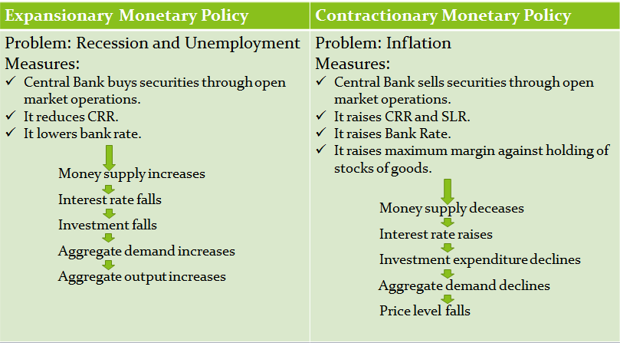
How does monetary policy affect inflation and other problems?
decreases
raises

Slide 13
FISCAL POLICY

Slide 14
Meaning
Fiscal policy deals with the taxation and expenditure decisions of the government. These include, tax policy, expenditure policy, investment or disinvestment strategies and debt or surplus management.

Slide 15
OBJECTIVES OF FISCAL POLICY
Increase in capital formation.
Degree of Growth.
To achieve desirable price level.
To achieve desirable consumption level.
To achieve desirable employment level.
To achieve desirable income distribution.

Slide 16
Fiscal Policy there are three possible positions
A Neutral position applies when the budget outcome has neutral effect on the level of economic activity where the govt. spending is fully funded by the revenue collected from the tax.
An Expansionary position is when there is a higher budget deficit where the govt. spending is higher than the revenue collected from the tax.
An Contractionary position is when there is a lower budget deficit where the govt. spending is lower than the revenue collected from the tax.

